Slide 1
The Role of Probability
CHAPTER 5

Slide 2
Learning Objectives (1 of 3)
Define the terms “equally likely” and “at random”
Compute and interpret unconditional and conditional probabilities
Evaluate and interpret independence of events
Explain the key features of the binomial distribution model

Slide 3
Learning Objectives (2 of 3)
Calculate probabilities using the binomial formula
Explain the key features of the normal distribution model
Calculate probabilities using the standard normal distribution table
Compute and interpret percentiles of the normal distribution

Slide 4
Learning Objectives (3 of 3)
Define and interpret the standard error
Explain sampling variability
Apply and interpret the results of the Central Limit Theorem

Slide 5
Two Areas of Biostatistics
Goal: Statistical Inference
Descriptive Statistics

Slide 6
Sampling from a Population

Slide 7
Sampling: Population Size = N, Sample Size = n (1 of 2)
Simple random sample
Enumerate all members of population N (sampling frame), select n individuals at random (each has same probability of being selected).
Systematic sample
Start with sampling frame; determine sampling interval (N/n); select first person at random from first (N/n) and every (N/n) thereafter.

Slide 8
Sampling: Population Size = N, Sample Size = n (2 of 2)
Stratified sample
Organize population into mutually exclusive strata; select individuals at random within each stratum.
Convenience sample
Non-probability sample (not for inference)
Quota sample
Select a predetermined number of individuals into sample from groups of interest.

Slide 9
Basics
Probability reflects the likelihood that outcome will occur.
0 ≤ Probability ≤ 1

Slide 10
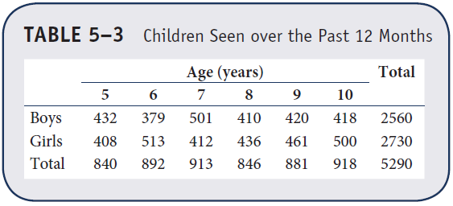
Example 5.1. Basic Probability (1 of 2)
P(Select any child) = 1/5290 = 0.0002

Slide 11
Example 5.1. Basic Probability (2 of 2)
P(Select a boy) = 2560/5290 = 0.484
P(Select boy age 10) = 418/5290 = 0.079
P(Select child at least 8 years of age)
= (846 + 881 + 918)/5290
= 2645/5290 = 0.500

Slide 12
Conditional Probability
Probability of outcome in a specific subpopulation
Example 5.1.
P(Select 9-year-old from among girls) = P(Select 9-year-old | girl)
= 461/2730 = 0.169
P(Select boy | 6 years of age)
= 379/892=0.425

Slide 13
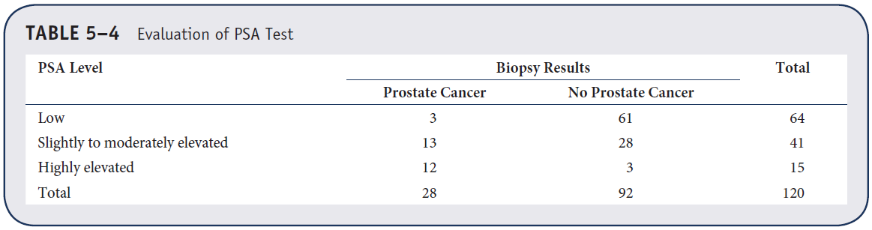
Example 5.2. Conditional Probability (1 of 2)

Slide 14
Example 5.2. Conditional Probability (2 of 2)
P(Prostate cancer | Low PSA)
= 3/64 = 0.047
P(Prostate cancer | Moderate PSA)
= 13/41 = 0.317
P(Prostate cancer | High PSA)
= 12/15 = 0.80

Slide 15
Sensitivity and Specificity
Sensitivity = True positive fraction
= P(test+ | disease)
Specificity = True negative fraction
= P(test– | disease free)
False negative fraction = P(test– | disease)
False positive fraction = P(test+ | disease free)

Slide 16
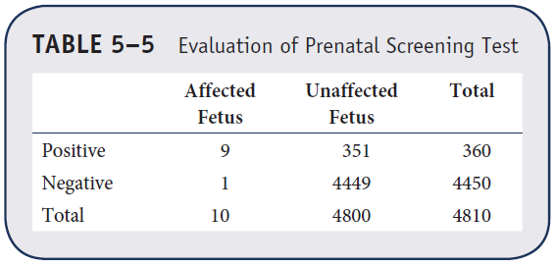
Example 5.4. Sensitivity and Specificity

Slide 17
Sensitivity and Specificity
Sensitivity = P(test+ | disease) = 9/10 = 0.90
Specificity = P(test– | disease free)
= 4449/4800 = 0.927
False negative fraction = P(test– | disease)
= 1/10 = 0.10
False positive fraction = P(test+ | disease free)
= 351/4800 = 0.073

Slide 18
Independence
Two events, A and B, are independent if P(A | B) = P(A) or if P(B | A) = P(B)
Example 5.2.
Is screening test independent of prostate cancer diagnosis?
P(Prostate cancer) = 28/120 = 0.023
P(Prostate cancer | Low PSA) = 0.047
P(Prostate cancer | Moderate PSA) = 0.317
P(Prostate cancer | High PSA) = 0.80

Slide 19
Bayes’ Theorem (1 of 2)
Using Bayes’ Theorem we revise or update a probability based on additional information.
Prior probability is an initial probability.
Posterior probability is a probability that is revised or updated based on additional information.

Slide 20
Bayes’ Theorem (2 of 2)

Slide 21
Example (1 of 2)
In Boston, 51% of adults are male.
One adult is randomly selected to participate in a study.
Prior probability of selecting a male = 0.51

Slide 22
Example (2 of 2)
Selected participant is a smoker.
9.5% of males in Boston smoke as compared to 1.7% of females.
Find the probability that we selected a male given he is a smoker.

Slide 23
Example: Find P(M | S)
P(M) = 0.51 P(M') = 0.49
P(S | M) = 0.095 P(S | M') = 0.017
Bayes’ Theorem
Knowing the participant smokes—increases P(M)

Slide 24
Example 5.8. Bayes’ Theorem (1 of 3)
P(disease) = 0.002
Sensitivity = 0.85 = P(test+ | disease)
P(test+) = 0.08 and P(test–) = 0.92
What is P(disease | test+)?

Slide 25
Example 5.8. Bayes’ Theorem (2 of 3)
What is P(disease | test+)?
P(disease) = 0.002
Sensitivity = 0.85 = P(test+ | disease)
P(test+) = 0.08 and P(test–) = 0.92

Slide 26
Example 5.8. Bayes’ Theorem (3 of 3)
P(disease) = 0.002
Sensitivity = 0.85 = P(test+ | disease)
P(test+) = 0.08 and P(test–) = 0.92

Slide 27
Binomial Distribution (1 of 2)
Model for discrete outcome
Process or experiment has two possible outcomes: success and failure.
Replications of process are independent.
P(success) is constant for each replication.

Slide 28
Binomial Distribution (2 of 2)
Notation
n = number of times process is replicated
p = P(success)
x = number of successes of interest
0 ≤ x ≤ n

Slide 29
Example 5.9. Binomial Distribution
Medication for allergies is effective in reducing symptoms in 80% of patients. If medication is given to 10 patients, what is the probability it is effective in 7?
= 120(0.2097)(0.008) = 0.2013

Slide 30
Binomial Distribution (1 of 4)
Antibiotic is claimed to be effective in 70% of the patients. If antibiotic is given to five patients, what is the probability it is effective on exactly three?
Success = Antibiotic is effective: n = 5, p = 0.7, x = 3
= 10(0.343)(0.09) = 0.3087

Slide 31
Binomial Distribution (2 of 4)
What is the probability that the antibiotic is effective on all five?

Slide 32
Binomial Distribution (3 of 4)
What is the probability that the antibiotic is effective on at least three?
P(X ≥ 3) = P(3) + P(4) + P(5)
= 0.3087 + 0.3601 + 0.1681 = 0.8369

Slide 33
Binomial Distribution (4 of 4)
Mean and variance of the binomial distribution
m = np
s² = np (1 – p)
For example, the mean (or expected) number of patients in whom the antibiotic is effective is 5*0.7 = 3.5

Slide 34
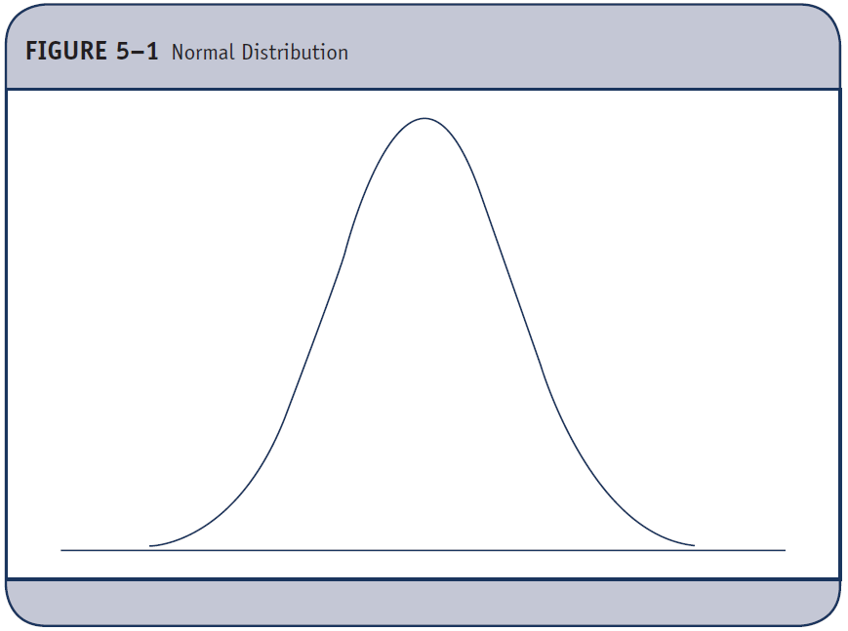
Normal Distribution (1 of 3)
Model for continuous outcome
Mean = median = mode

Slide 35
Normal Distribution (2 of 3)
Notation: μ = mean and σ = standard deviation
μ−3σ μ−2σ μ−σ μ μ+σ μ+2σ μ+3σ

Slide 36
Normal Distribution (3 of 3)
Properties of normal distribution
I) The normal distribution is symmetric about the mean (i.e., P(X > μ) = P(X < μ) = 0.5).
ii) The mean and variance, μ and σ², completely characterize the normal distribution.
iii) The mean = the median = the mode.
P(μ - σ < X < μ + σ) = 0.68
P(μ - 2σ < X < μ + 2σ) = 0.95
P(μ - 3σ < X < μ + 3σ) = 0.99
iv) P(a < X < b) = the area under the normal curve from a to b.

Slide 37
Example 5.11. Normal Distribution (1 of 10)
Body mass index (BMI) for men age 60 is normally distributed with a mean of 29 and standard deviation of 6.
What is the probability that a male has BMI less than 29?

Slide 38
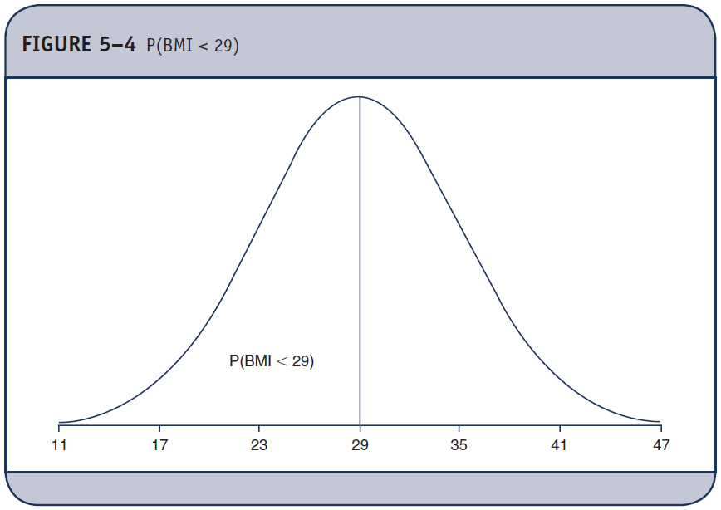
Example 5.11. Normal Distribution (2 of 10)

Slide 39
Example 5.11. Normal Distribution (3 of 10)
P(X<29)=0.5
0.5 0.5
11 17 23 29 35 41 47

Slide 40
Example 5.11. Normal Distribution (4 of 10)
Body mass index (BMI) for men age 60 is normally distributed with a mean of 29 and standard deviation of 6.
What is the probability that a male has BMI less than 35?

Slide 41
Example 5.11. Normal Distribution (5 of 10)
P(X<35)=?
11 17 23 29 35 41 47

Slide 42
Example 5.11. Normal Distribution (6 of 10)
P(X < 35) = 0.5 + 0.34 = 0.84
0.5 0.34
11 17 23 29 35 41 47

Slide 43
Standard Normal Distribution Z
Normal distribution with μ = 0 and σ = 1
-3 -2 -1 0 1 2 3

Slide 44
Example 5.11. Normal Distribution (7 of 10)
P(X < 35) = P(Z < 1) = ?
11 17 23 29 35 41 47

Slide 45
Example 5.11. Normal Distribution (8 of 10)
P(X < 35) = P(Z < 1).
Using Table 1, P(Z < 1.00) = 0.8413
Table 1. Probabilities of Z
Table entries represent P(Z < Zi)
Zi .00 .01 .02 .03 .04 …
0.0 0.5000 0.5040 0.5080 0.5120 0.5160 …
0.1 0.5398 0.5438 0.5478 0.5517 0.5557 …
.
.
1.0 0.8413 0.8438 0.8461 0.8485 0.8508 …

Slide 46
Example 5.11. Normal Distribution (9 of 10)
What is the probability that a male has BMI less than 30?
P(X<30)=?
11 17 23 29 35 41 47

Slide 47
Example 5.11. Normal Distribution (10 of 10)
P(X < 30)= P(Z < 0.17) = 0.5675

Slide 48
Percentiles of the Normal Distribution
The kth percentile is defined as the score that holds k percent of the scores below it (e.g., 90th percentile is the score that holds 90% of the scores below it.
Q₁ = 25th percentile
Median = 50th percentile
Q₃ = 75th percentile

Slide 49
Percentiles (1 of 2)
For the normal distribution, the following is used to compute percentiles:
X = μ + Z σ
where
μ = mean of the random variable X,
σ = standard deviation, and
Z = value from the standard normal distribution for the desired percentile (See Table 1A, next slide).

Slide 50
Percentiles (2 of 2)
Percentiles of the standard normal distribution
(Table 1A)
Percentile | Z
1st | –2.326
2.5th | –1.960
5th | –1.645
10th | –1.282
50th | 0
90th | 1.282
95th | 1.645
97.5th | 1.960
99th | 2.326

Slide 51
Example 5.12. Percentiles of the Normal Distribution
BMI in men follows a normal distribution with μ = 29, σ = 6; BMI in women follows a normal distribution with μ = 28, σ = 7.
The 90th percentile of BMI for men
X = 29 + 1.282(6) = 36.69.
The 90th percentile of BMI for women
X = 28 + 1.282(7) = 36.97.

Slide 52
Central Limit Theorem
Suppose we have a population with known mean μ and standard deviation σ. If we take simple random samples of size n with replacement, then for large n, the sampling distribution of the sample means is approximately normal with mean and standard deviation.

Slide 53
Application
Non-normal population
Take samples of size n, as long as n is sufficiently large (usually n ≥ 30 suffices).
The distribution of the sample mean is approximately normal, therefore can use Z to compute probabilities.

Slide 54
Example 5.18. Central Limit Theorem (1 of 2)
HDL cholesterol has a mean of 54 and standard deviation of 17 in patients over 50. A physician has 40 patients over age 50 and wants to know the probability that their mean cholesterol is above 60.

Slide 55
Example 5.18. Central Limit Theorem (2 of 2)

Slide 56
Example
Suppose we wish to estimate the mean of a population (μ) whose standard deviation is known and equal to 12, and a simple random sample of 100 individuals is selected from the population.
Find the probability that the sample mean is no more than 2 units from the population mean.

Slide 57
Sampling Distribution of Sample Mean

Slide 58
Central Limit Theorem
P( μ – 2 < < μ + 2) = ??
Z = { (μ – 2) – μ }/12/√100 = –2/1.2 = –1.67
Z = { (μ + 2) – μ }/12/√100 = 2/1.2 = 1.67
Then: P(–1.67 < Z < 1.67) = 0.9525 – 0.0475 = 0.905
The probability that the sample mean is no more than 2 units from the population mean is 0.905, or 90.5%.

